Slide 1
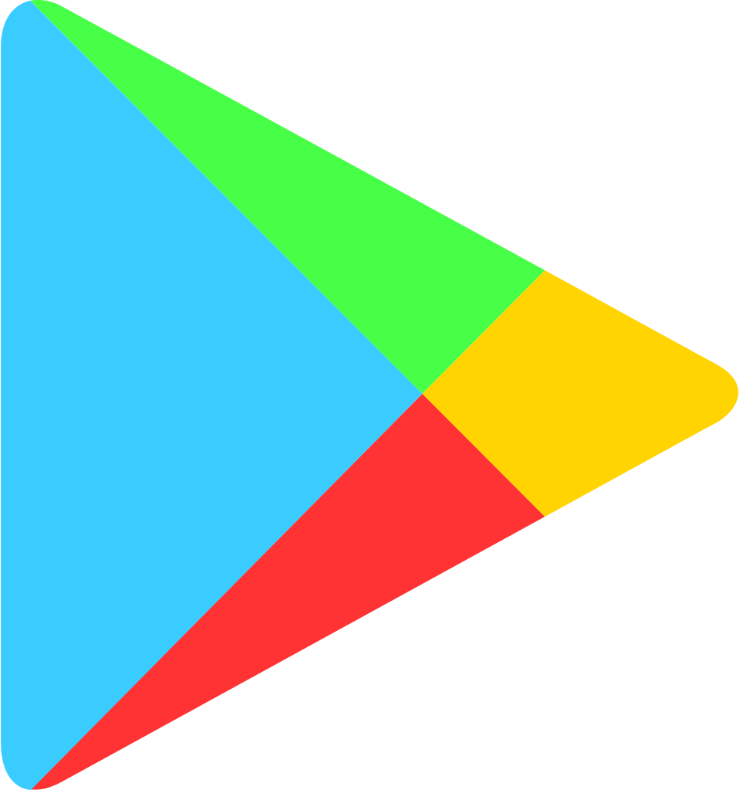
Capstone Project
Play Store App Review Analysis Team members Akshay Kumar Saini Kumkum Singh

Slide 2
Content
Introduction
Problem definition
Description of Dataset
Data cleaning
Data Analysis & Visualization
Important points get after Data visualization
Work on Sentiment Analysis (2nd Data Set)
Conclusion

Slide 3
INTRODUCTION
Play store is digital distribution service developed by google. Play store was launched in 2012. It acts as an official platform for certified devices running on the android operating system and its derivatives.
Play store provides many applications for the android users. Most of these applications are charges free and some of them are have some cost.
These applications can be directly downloaded from the play store.

Slide 4
INTRODUCTION
The Google Play Store provided over 82 billion app in 2016 and reached over 3.5 million apps in 2017, while after a purge of apps is back to over 3 million.
It has been the subject of multiple issues concerning security, in which malicious software has been approved and uploaded to the store and downloaded by users, with varying degrees of severity.
Google play provides applications for movies, gaming, T.V. shows, e-books, magazines, etc. It has become the biggest and most important part of android.

Slide 5
PROBLEM STATEMENT:
The Problem statements are: -
Does the size of an app affects the rating?
Does the price of an app affects the number of people downloading the application?
To find out the highest rated application.
Does the rating of the app affects the number of people downloading the app?
To find out which category has highest app?

Slide 6
DESCRIPTION OF DATASET:
We were provided with two data sets.
1) Play Store Data:
App : The name of the app
Category : The category of the app
Rating : The rating of the app in the Play Store
Reviews : The number of reviews of the app
Size : The size of the app
Install : The number of installs of the app
Type : The type of the app (Free/Paid)
The price of the app (0 if it is Free)
content Rating :The appropriate target audience of the app
Genres: The genre of the app
Last Updated : The date when the app was last updated
Current Ver : The latest version of the app
Android Ver : The minimum Android version required to run the app

Slide 7
DESCRIPTION OF DATASET:
2)User Review Data:
App – An app name
Sentiment – Sentiment given to an app by users ( i.e Positive, Neutral, Negative)
Sentiment Polarity – The polarity of sentiment measures how negative or positive the context is. In the data we have, the polarity ranges from +1(Positive) to -1(Negative).
Sentiment Subjectivity - The subjectivity of a sentiment is how likely that sentiment is to be based on data or factual information, versus personal opinions or public notions

Slide 8
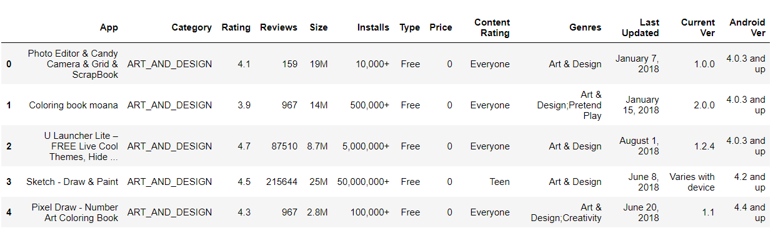
Data Cleaning:
STEPS INVOLVED IN DATA CLEANING: -
Converting values of install column into integer and removing “+” and “,” signs.
Converting values of price column into integer and removing “$” sign.
Converting values of review column into integer.
4. Converting values of size column into integer and removing “M” and “K”.

Slide 9
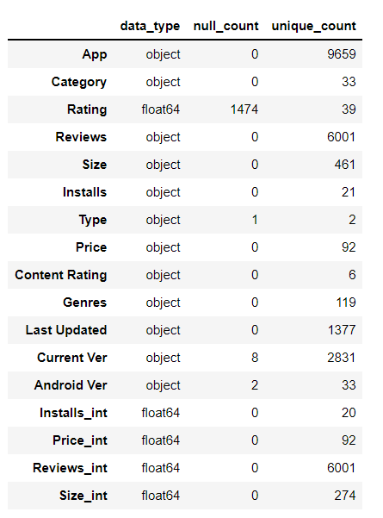
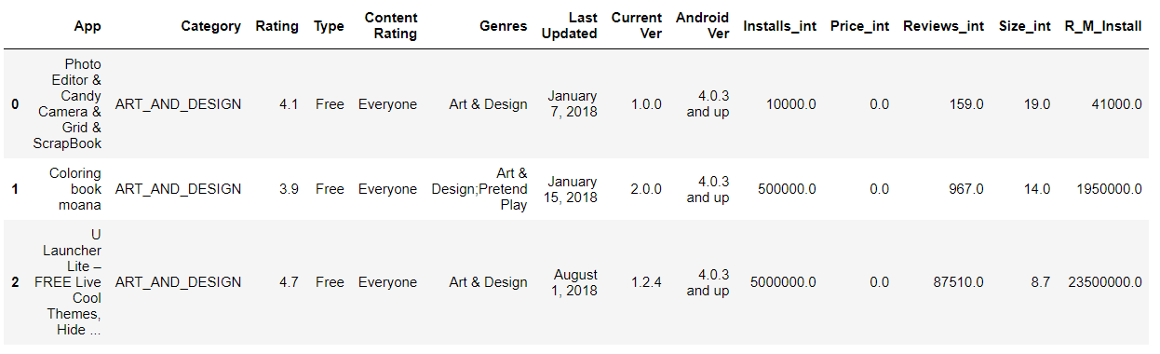
Data Cleaning(cont.):
Replacing Rating(null) values with the average rating of category.
Removing the Data with the null value
Clean Data

Slide 10
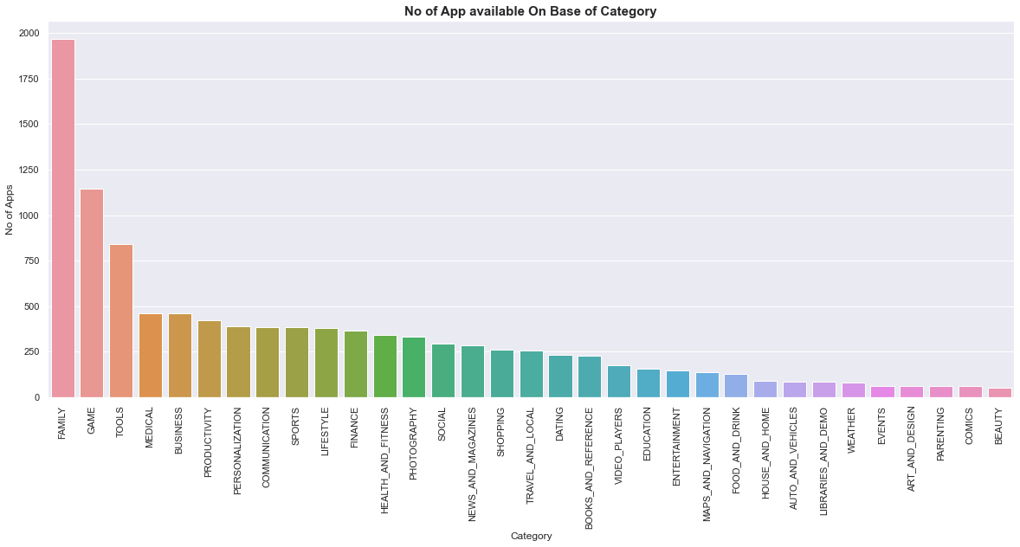
Data Analysis & Visualization:
Most number of app in play store belong to the family category app, which have around 1900 apps
Followed by the Game category ,which have around 1175 app in play store

Slide 11
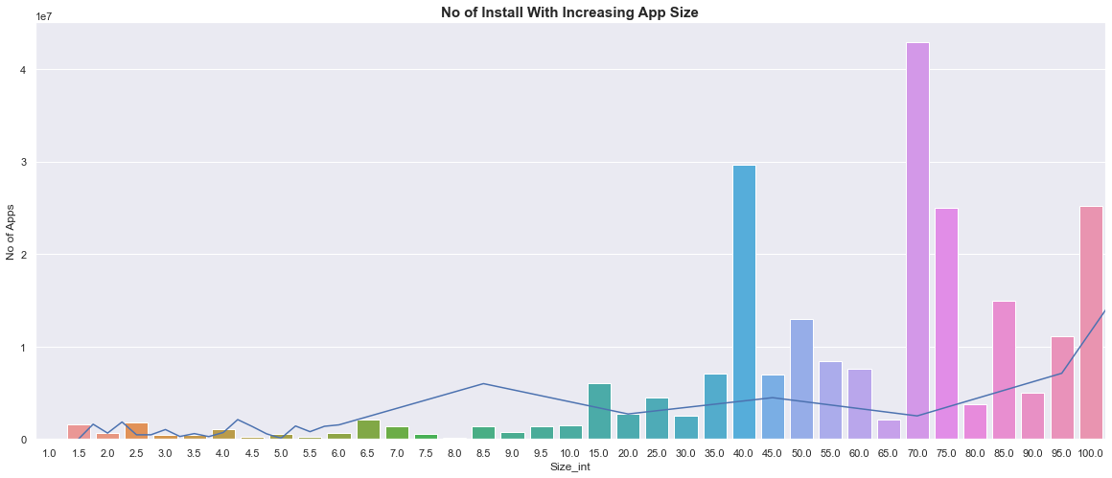
Data Analysis & Visualization(cont..):
This bar graph show the relation between the size and no of installation.
From Graph it can be seen 40MB and 70-75 MB apps are the most installed app

Slide 12
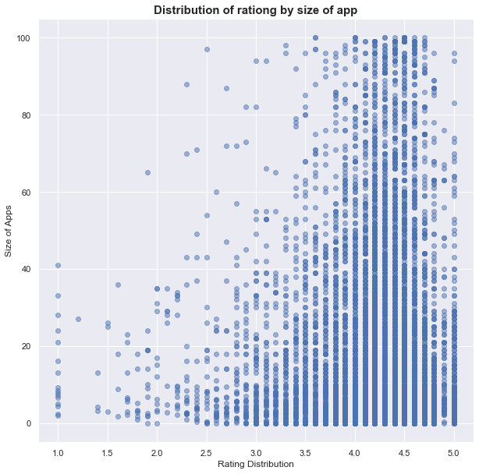
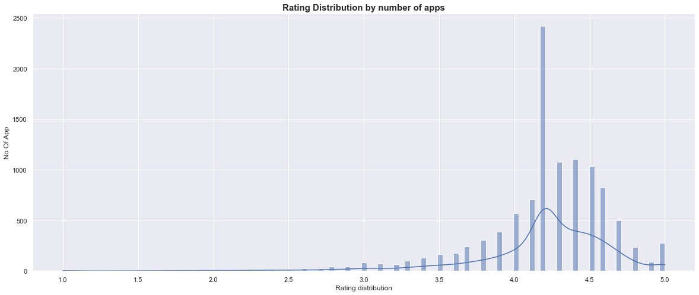
Data Analysis & Visualization(cont..):
In this bar graph and the scatter plot we can clearly see most of the apps rating is distributed 4-4.5 rating.
Max no of have 4.1 Rating(too High)

Slide 13
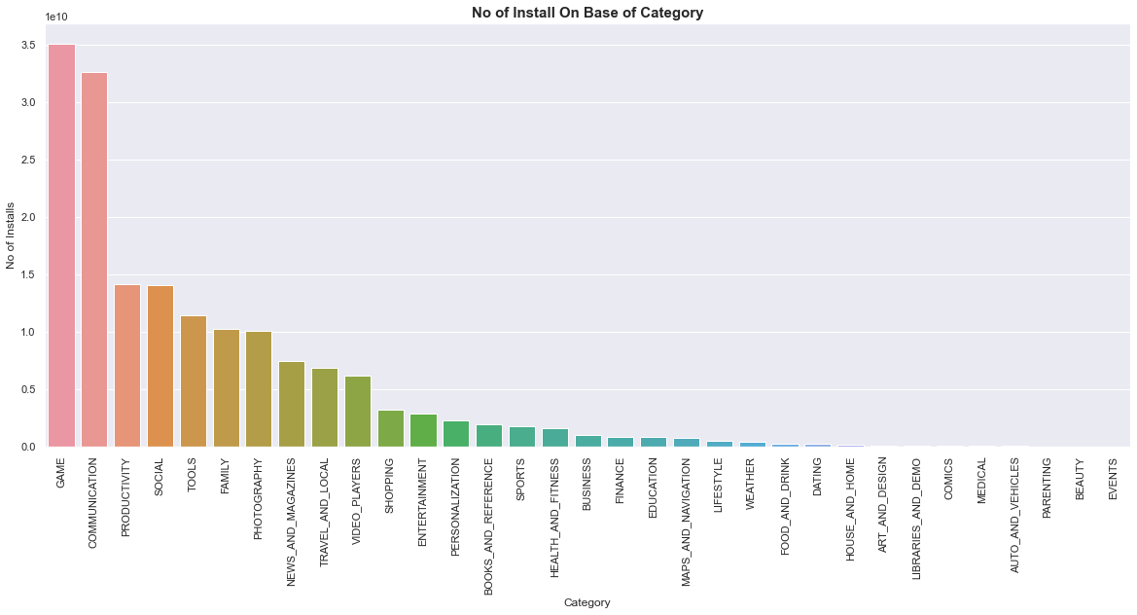
Data Analysis & Visualization(cont..):
In this bar graph, the height of bar define the number of installation and in the x-axis all categories are defined
We can se Game categories app are the most installed apps, followed by the Communication category app

Slide 14
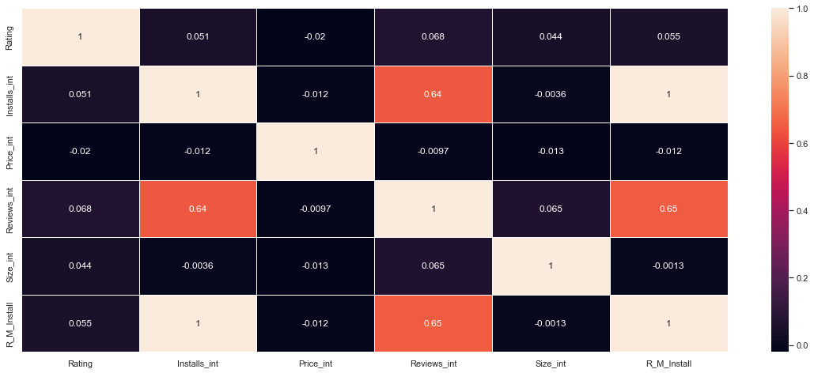
Data Analysis & Visualization(cont..):
This is the correlation heatmap of the
We can see Review and install have a correlation of 0.62 which means, who ever installs the app ,leaves the review or feedback.
There is also a correlation between R_M_Install and Reviews of 0.65.

Slide 15
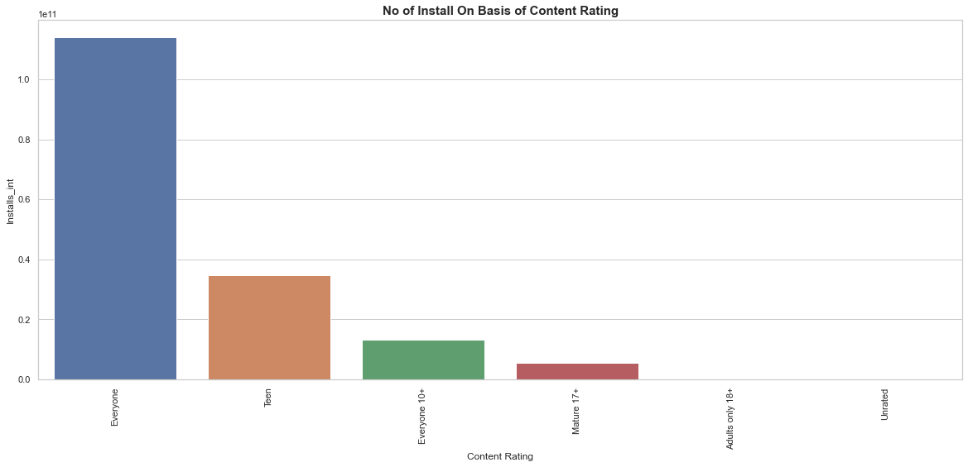
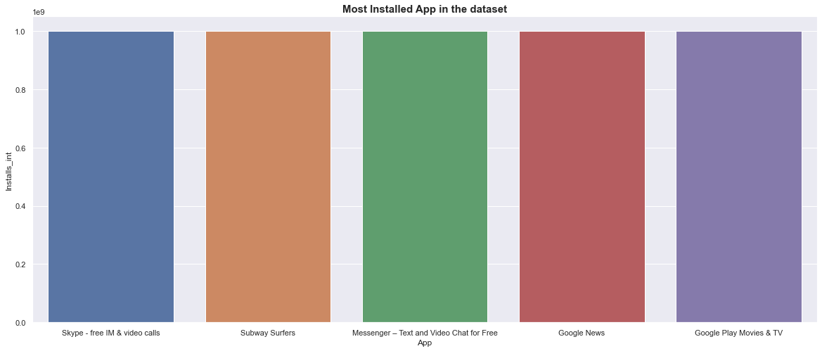
Data Analysis & Visualization(cont..):
This bar graph show the app which are installed maximum time
Skype is the most installed app followed by Subway Surfer
This bar Graph show the No of installs on the basis of Content Rating.
From Graph we can se ‘Everyone’ content rating apps are the most installed apps

Slide 16
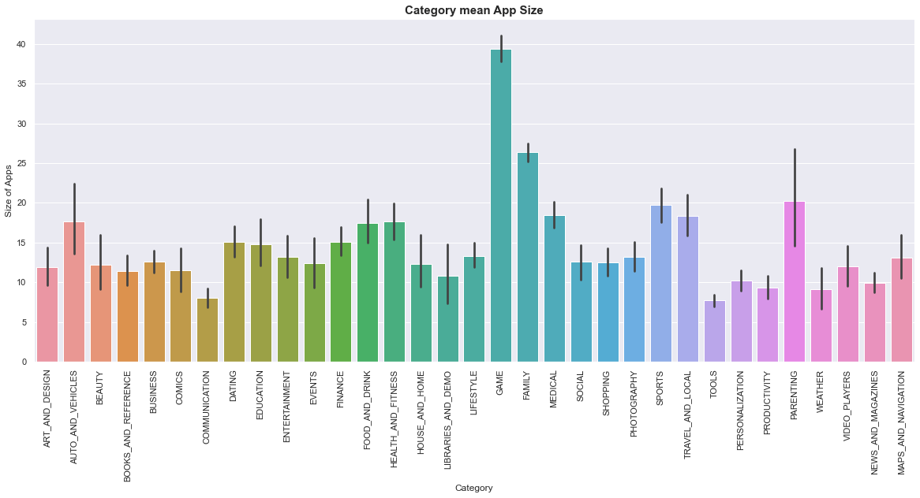
Data Analysis & Visualization(cont..):
In this bar graph, the height of bar define the average size of that category
Game apps have the Highest average app size
Followed by the Family category app
Average size of app of all the category is between 10-20MB

Slide 17
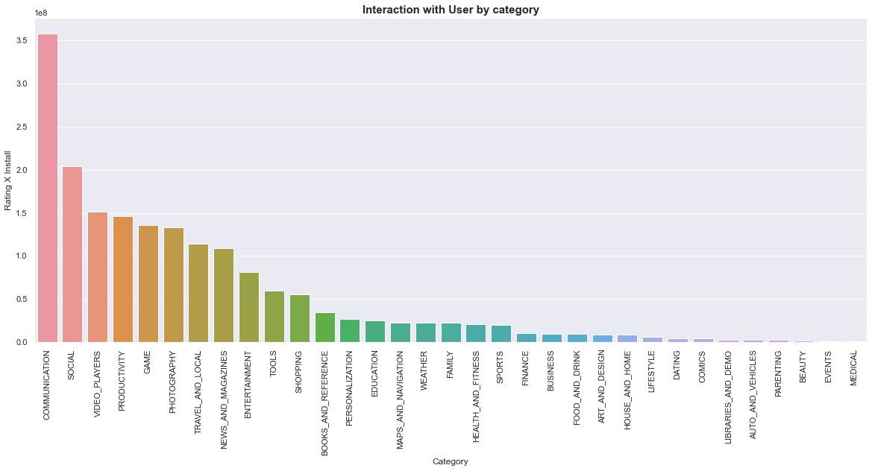
Data Analysis & Visualization(cont..):
R_M_Install is define as the Product of Rating and Install
Which Means The no of stars user has given, also it tells the how frequently user interact with app
We can see Communication Category have the most interaction , followed by the Social category app

Slide 18
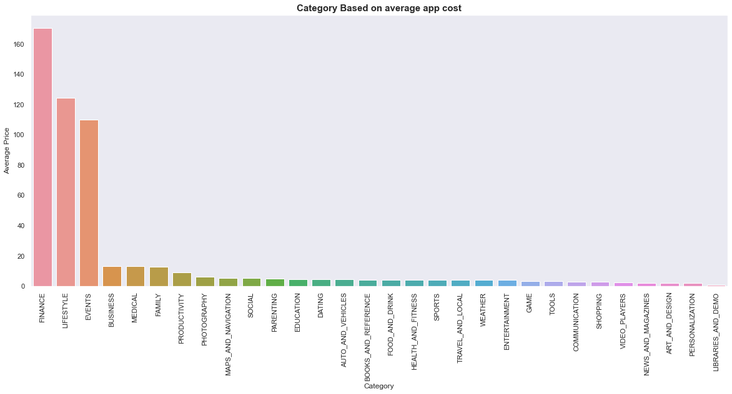
Data Analysis & Visualization(cont..):
This graph show the average price in the paid app category.
We can see the Finance category app are the most expensive app , followed by the Lifestyle

Slide 19
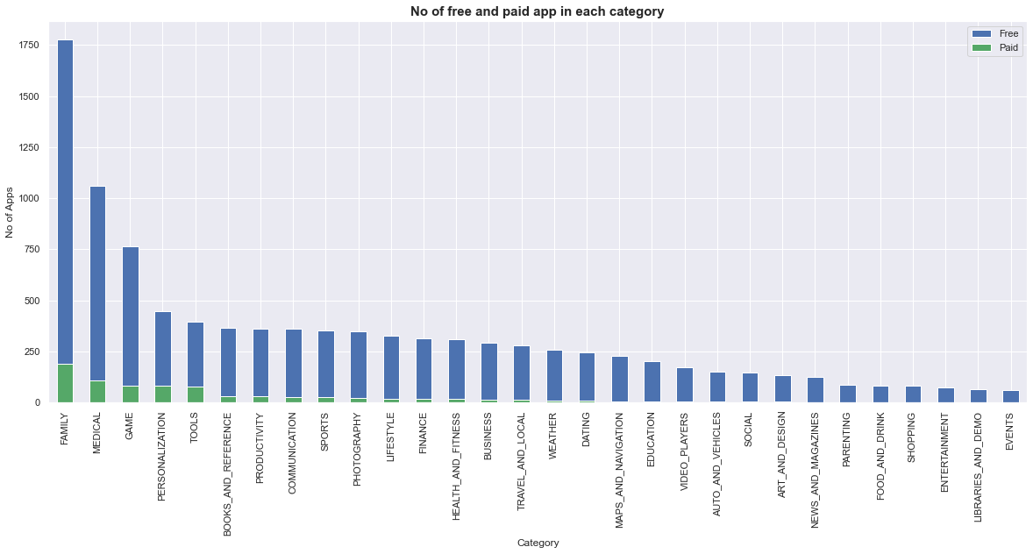
Data Analysis & Visualization(cont..):
This Stack Bar graph Show the Free and Paid app in each category
As we can see, in every category around 14% app are paid

Slide 20
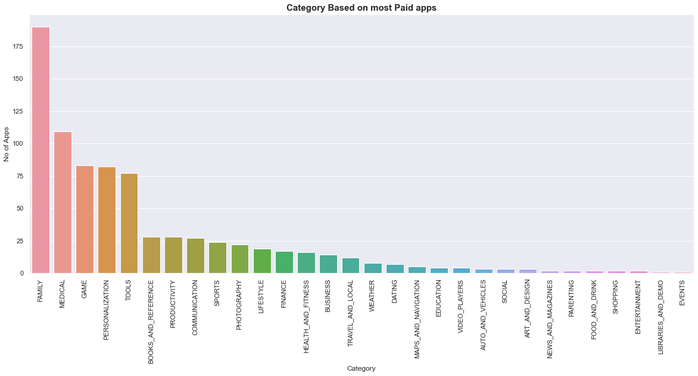
Data Analysis & Visualization(cont..):
This Bar graph Show the No. of paid apps in each category
Family category have the highest no. of paid app, followed by Medical and Game

Slide 21
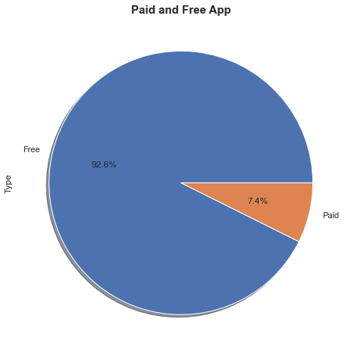
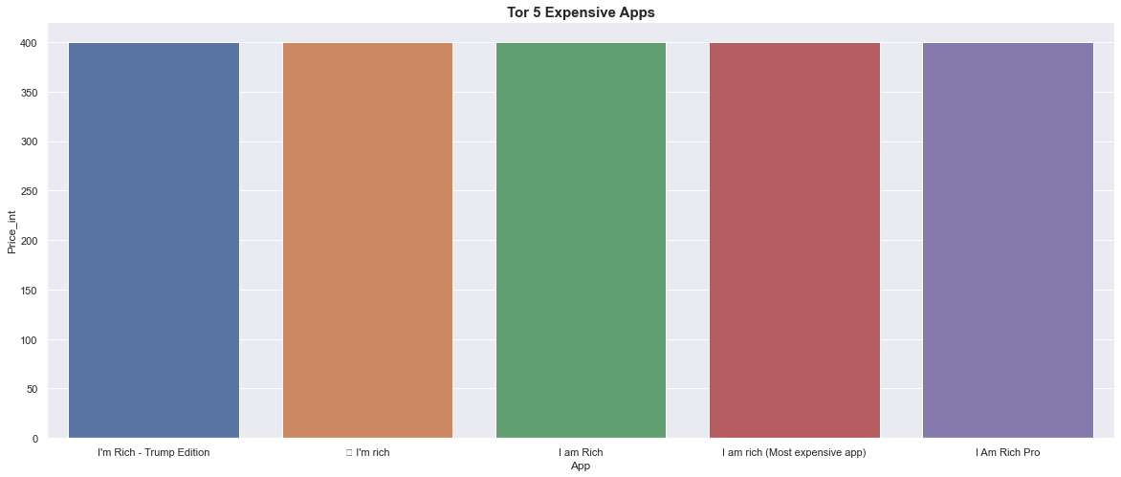
Data Analysis & Visualization(cont..):
This Bar Graph show the highest paid apps among all the apps available in play store
Pie chart show the all apps on the basis of free and paid type
Free App: 92.6%
Paid App:7.4%

Slide 22
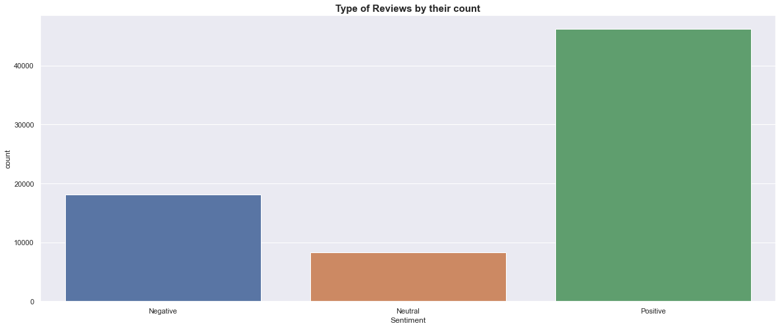
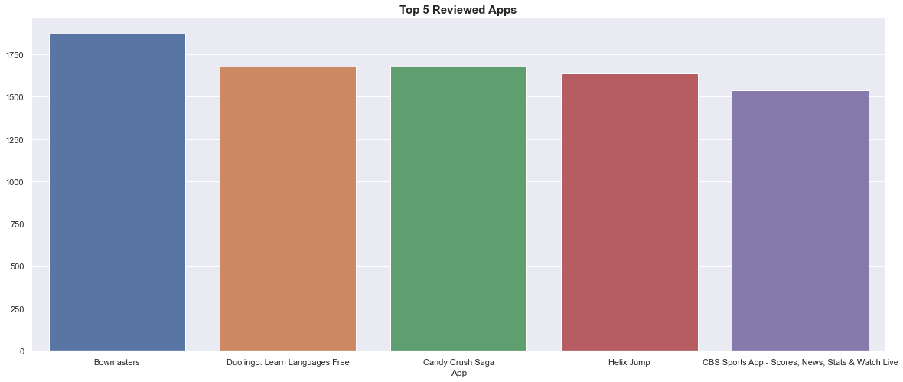
Data Analysis & Visualization(cont..):
Sentiment analysis(2nd DataSet)
From the Second dataset
This graph show the top 5 apps having most reviews
This bar graph show the Sentiment of review and their Count
From Graph we can see ,there are maximum number of positive reviews

Slide 23
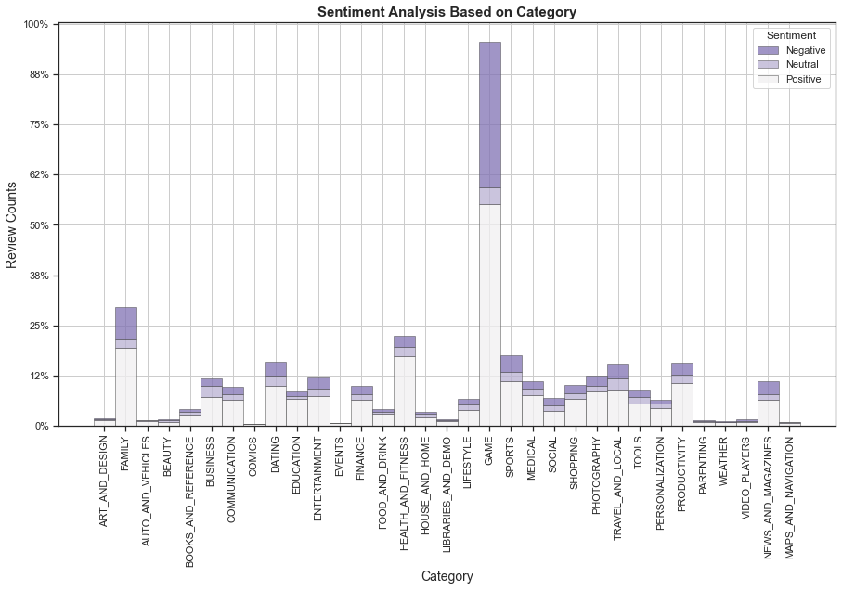
Data Analysis & Visualization(cont..):
This bar graph show Reviews stack in each category
From Graph we can see ,Game category apps have maximum number of reviews, and half of them are negative and positive and small number of neutral Review
Then it is followed by Family category

Slide 24
Some important question cover after Data Visualization:
Rating distribution on basis of no of apps .
Top 5 app with most installation.
No of installation with respect to content rating
Total no of apps available on the base of category.
Effect on the No of installation with the increasing app size
Mean size of the app in each Category
Interaction with user by each category
Category Based on average app cost(only paid apps included)
Top 5expensive apps in play-store.
Comparison of Free and paid apps in each category
Overall review of playstore
Top 5 app which get Most translated_review.

Slide 25
Some important points we get:
Average rating of apps on Google Play Store is 4.19.
BY R_M_Install(variable) we have seen the communication and social category apps are most installed apps
Finance and Lifestyle apps are the most expensive and even extend up to 400$.
Review and Install has a correlation of 0.64, which means users tend to download a given app more if it has been reviewed by a large number of people.
More than half users rate Family, Sports and Health & Fitness apps positively. Apps for games and social media get mixed reviews, with 50 percent positive and 50 percent negative responses.

Slide 26
Conclusion
The Google Play Store Apps report gives a few helpful insights about the moving of the applications in the play store. According to the diagrams representations displayed above, a large portion of the moving applications (as far as clients' introduces) are from the categories like GAME, COMMUNICATION, and PRODUCTIVITY despite the fact that how much accessible applications from these classifications are two times as a lot lesser than the category FINANCE and LIFESTYLE yet utilized most.
Family category has the maximum number of apps in Play Store not installed too much.

Slide 27
Conclusion(cont.):
Despite the fact that applications from the classes like GAME, SOCIAL, COMMUNICATION and TOOL of having the most elevated measure of introduces, rating and surveys are mirroring the latest thing of Android clients, they are not in any event, showing up as classification in the best 5 most costly applications in the store .
Game Category have the most no of reviews and the maximum number of intallation
As an end, we discover that the latest thing in the Android market are for the most part from these classes which either helping, conveying or engaging applications.

Slide 28
Conclusion(cont.):
Key factors responsible for app engagement and success:
If it Belong to the Game, Communication, Productivity ,Social category ,then it have a high probability to success as compared to other categories
Free apps are tends to be more installed as compare to free apps
Size of the Apps should be around 40 MB or 70-80MB to increase the probability of Success
App Content Rating should be in ‘Everyone’ as ,Everyone Content rating apps are most installed app.

Slide 29
Thankyou

